Slide 1
The Missing Pieces
To Building and Adopting AppSec Capabilities
January 2023

Slide 2
Introduction

Slide 3
Jon Shapransky
Technical Principal Consultant @ Kroll.
10+ years in security and consulting.
Worked with public and private sector clients from startups to Fortune 100s across a variety of industries and countries.
Presently focused on helping clients build Application Security/Product Security programs and capabilities.
Technical Principal Consultant
Note: The above photo was taken in the “before times”.
Notes:
This is me from the “before times”.
[READ SLIDE]

Slide 4
What is this talk?
“Standing on the shoulders of giants”
Personal approach and experience
Notes:
Mix of my personal approach and experience;
Combined with the research and experience of experts;
To help with framing and expressing concepts I find critical to achieving developed, implemented, and;
Most importantly adopted capabilities.
I also believe knowledge from outside our domain can be applied to help us solve a problem.

Slide 5
Quick show of hands…
We bought this tool X years ago and nobody is using it (and the renewal is coming up).
The audit said we should be doing X so we bought a tool for X but we are not seeing any results.
X is supposed to be “self-service”, but nobody has adopted it.
We are supposed to do X, but we are not sure how or who is responsible.
Our policy says that we must do X, but it’s often forgotten, not done, or performed too late to provide value and just causes frustrations for everyone.
We have a team that does X, but their process isn’t “agile”, and they take too long to respond and provide their input.
Notes:
Quick show of hands;
Do any of these sound familiar?
[Hopefully, hands go up…]
Super! That’s why I’m here today giving this talk.

Slide 6
Why this talk?
A problem unidentified is a problem unresolved… and I think we have a problem.
Organizations heavily invest and rely on tools and technology to fill capability gaps but fail at successful adoption. This results in:
Spending hundreds of thousands, if not millions, of dollars annually without realizing any benefits.
A demonstrable unresolved capability gap.
When we fail to plan we plan to fail.
Hope is not a strategy.
Notes:
Why this talk?
I like to say, “a problem unidentified is a problem unresolved”;
I think we have a problem;
So, what’s the problem?
[Read #2 and sub-points]
Where does this problem come from?
The last 2 bullets are adages that standout to me and relate to this problem.
[Read #3 and #4]

Slide 7

Why this talk?
OWASP SAMM, BSIMM, NIST SSDF, NIST CSF, ISO 27034, Etc.
We are told what we need or should be doing (i.e., industry “best practices”).
We are told the technical how-to. (i.e., how to threat model or penetration test, etc.)
We know the tools that help support capabilities.
But… How should these all be implemented as capabilities? How do we get these things adopted?
Source: https://xkcd.com/927/
Notes:
There’s a little bit more;
We love our frameworks and standards that tell us what controls and capabilities we should have;
Added to these are regulations and standards that specific industries MUST comply with for various reasons;
There are contractual requirements or general market expectations to also meet;
All of this is telling us what we need to have in place and perhaps why.
Some of the how is available, both through tools and methodologies;
but if these are to become capabilities and practices, how should they be implemented?
How do we ensure that they are adopted and become standard “business as usual”?

Slide 8
Our Journey Today
Introduction
Capability Development
Organizational Change Management
Adoption
Team Topologies
Services
Self-Guided Services
Capability Measurement
We Are Here
Notes:
At this point in our journey;
you know who I am;
what this talk is;
and why this talk so where are we going to go from here?

Slide 9
Goal for Today (Takeaways)
A mental framework that enables you to:
Think about how to approach developing or improving capabilities.
Understand capability and service adoption.
Understand how team structure and interactions affect adoption.
Consider a different way to measure success when developing and improving capabilities that focus more on successful adoption first, results second.
Notes:
Quick disclaimer: The topics I’m trying to cover in this talk can each individually be talks.
This talk tries to summarise and present the core ideas and;
Draw the relationship between each to give you something to think about the next time you need to develop or improve capabilities.
So, our goals for today are;
To provide a framework that gives you a way to think about;
How to approach developing and improving capabilities;
Understand adoption;
Understand how team structures and interactions affect adoption; and
How to approach defining and measuring success differently.

Slide 10
Capability Development
Notes:
Capability Development!

Slide 11
What is a Capability?
A capability is “the ability or power to do something.”- Cambridge Dictionary
Any activity that is supported and enabled through:
People
Process
Procedure
Technology
Application Security capabilities are practices and processes that help us identify and/or reduce risks to improve security.
A tool is not a capability; it only supports capabilities.
Notes:
[Read #1]
For us, what does this mean?
[Read #2 and sub-points]
Looking more closely at our domain;
[Read #3]
Most importantly though;
A tool is not in itself a capability;
Tools only support capabilities.

Slide 12
Example of AppSec Capabilities
Examples within Application Security include:
Threat Modelling
Security Architecture Review
Secure Coding
Security Testing (Automated and Manual)
Risk Assessments
Code Review
Security Training
Vulnerability Management
Risk Management
Notes:
Some examples of AppSec capabilities.
Capabilities may be larger programs;
Example: Your VM program as a whole is a capability;
Or they may be smaller activities (processes)
Example: Static Application Security Testing

Slide 13
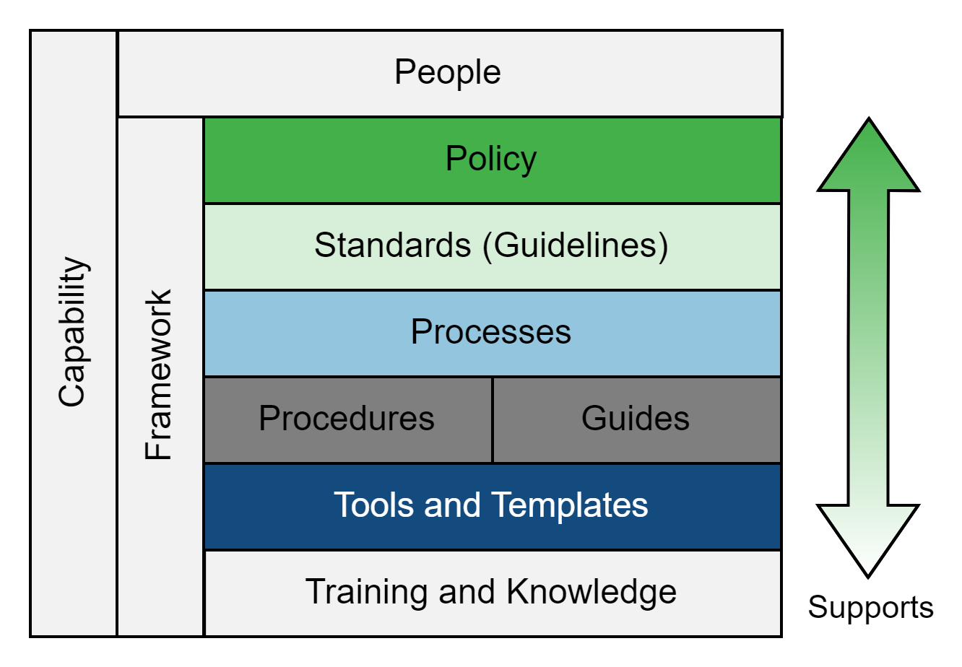
Capability Framework
Notes:
Every capability will include some or all components that are depicted in this diagram;
When developing a capability you may not need everything;
but at a minimum, you should ask yourself "do we need it?“
The need for each component will depend on your strategy and desired outcomes for the capability.
Example: Capability that will be provided as a service and performed by a team of specialists may require only the right people and a policy;
However, a capability that is intended to be self-guided or self-service will likely require some aspects of all components to achieve the desired state.

Slide 14
Capability Development Goals
A good target CMMI maturity level is “Defined”.
Build solid foundations to adequately support the capability:
Having the right people
Having the right governance
Policy
Standards
Processes and Procedures
Guides
Having the right tools
Having the right processes and technology integrations and automations
Notes:
A capability may be performed ad hoc;
or may be well-defined, managed, and optimized.
Although the level of maturity will vary from capability to capability and from organization to organization;
What’s important is to know that the level of maturity will directly affect your organization’s ability to perform the capability consistently.
So, generally, a good target state for any capability is “defined” and perhaps even “managed”.
That is, components of the capability’s framework are documented, socialized, shared, accessible, and updated as-needed to ensure that the capability continues to meet its objectives.
When developing a capability we should have to have good foundations to support the capability;
[Read #2 sub-points]

Slide 15
Capability Development Approach
Discover
Plan
Build
Pilot
Refine
Launch
Notes:
So, you’ve identified the need for a new capability;
The need to improve (or fix) an existing capability;
What’s next?
Where should you start?
What should the process look like?
Here is the approach I like to use for capability development.
I like to break it does into 6 phases that lead us up to a point of beginning to institutionalize and operationalize the capability.
That mean, this approach is leaving out the operational state activities such as “maintain”.

Slide 16
Capability Development Approach
Discover
Plan
Build
Pilot
Refine
Launch
Conduct stakeholder interviews to understand the current state and desired future state (vision).
Conduct user experience interviews to identify current issues, challenges, pain points and opportunities for improvement.
Review current toolset and associated documentation.
Review current processes and procedures, configurations, usage, etc.
Identify technology and development environment.
Gather and define business and technical requirements.
Understand business drivers, goals, and objectives.
Identify dependencies and gaps.
Notes:
In the discover phase we want to;
Fully understand the current state, desired future state (vision), drivers, requirements, etc.
Some of the activities would include:
Conducting stakeholder interviews to understand the current state and desired future state;
Conducting user-experience interviews to identify and understand current issues, challenges, or pain points;
Reviewing current tool sets and associated documentation;
Reviewing current tool processes and procedures, configurations, usage, etc.;
Identifying the technology and development environment;
Gathering and defining business and technical requirements;
Understanding business drivers, goals, and objectives; and
Identifying dependencies and gaps

Slide 17
Capability Development Approach
Discover
Plan
Build
Pilot
Refine
Launch
Identify and define the definition and purpose of the capability independent of the technology and solution that will be used to support the implementation of the capability.
Determine and define the scope and applicability including any conditions or exclusions.
Identify the goals, objectives, and supporting metrics.
Identify the desired future, vision, state.
Identify program and capability enablers.
Design capability and program architecture (i.e., processes, procedures, integrations, etc.).
Identify and define change management plan(s).
Identify and define an implementation roadmap.
Notes:
In the plan phase we want to:
Define the strategies and architecture for the capability.
This involves identifying and defining:
The definition and purpose of the capability;
The scope and applicability;
The goals, objectives, and supporting metrics;
The desired future state;
Capability enablers (the framework from a few slides back);
The architecture (i.e., the processes, procedures, integrations, and how everything will work together);
Change-management plan(s); and
implementation roadmap

Slide 18
Capability Development Approach
Discover
Plan
Build
Pilot
Refine
Launch
Design and develop the capability framework and documentation (e.g., policies, processes, procedures, templates, etc.).
Design and develop supporting resources (e.g., training, knowledge base content, guides, etc.).
Tool evaluation and selection.
Tool deep-dive to build in-depth knowledge and understand full features and capabilities.
Identify opportunities to refine and optimize tool usage and procedures to meet capability goals.
Develop required supporting change management communications and material.
Notes:
In the build phase we want to:
Implement and execute the strategies defined in the planning phase.
This process includes:
Designing and developing the capability framework and documentation (e.g., policies, processes, procedures, and templates);
Designing and developing supporting resources (e.g., training, knowledge-base content, and guides);
Evaluating and selecting tools;
Building in-depth knowledge and understanding of the selected tool’s features and capabilities;
Identifying opportunities to refine and optimize tool usage and procedure to meet capability goals; and
Developing required supporting change-management communications and materials.

Slide 19
Capability Development Approach
Discover
Plan
Build
Pilot
Refine
Launch
Identifying between 5 and 10 teams to work with and support the pilot.
Execute capability processes and procedures from team onboarding, training, through to execution and support.
Conduct the pilot over a defined period to allow development teams and stakeholder groups time to adopt the new capability and provide feedback (i.e., 3 months).
Collect feedback and adjust as-needed.
Notes:
At the pilot phase, we want to:
Engage a small number of teams to test the new capability and its processes, procedures, tools, etc. end-to-end.
This involves:
Identifying five to ten teams to work with and support the pilot;
Executing the processes and procedures from team onboarding and training through to execution and support;
Letting the pilot run for a period to allow stakeholder groups involved time to adopt the new capability and provide feedback; and
Collecting feedback to adjusting the capability framework as needed.

Slide 20
Capability Development Approach
Discover
Plan
Build
Pilot
Refine
Launch
Deliberately and actively seeking feedback from teams involved in the pilot.
Adjusting processes, procedures, tools, training, and related documentation based on feedback.
Notes:
After the pilot we have a phase to refine the capability;
That is to, seek feedback and adjust processes, procedures, tools, training, and related documentation as needed prior to a full launch;
This should entail:
Actively seeking feedback from teams that were involved in the pilot;
Asking what went well? what can be better? Any challenges?;
A question I like to ask is “how can we better help you, help us?”;
Adjusting the framework as-needed based on feedback.
The goal with refining is to improve the stakeholder experience, reduce friction, and improve the likelihood of successful adoption.

Slide 21
Capability Development Approach
Discover
Plan
Build
Pilot
Refine
Launch
The final stage of capability development is the launch.
Launching does not represent the end but instead represents a shift from development activities into implementation and operational activities.
Scaling the capability beyond the pilot teams to the teams and systems in scope.
Involves executing the implementation strategy and associated change management plan(s).
Performing outreach.
Socialization of the capability and raising awareness.
Onboarding teams and performing training.
Fully supporting the implementation and integration of the capabilities.
Following up to confirm that progress is going well and actively solving challenges.
Notes:
Finally, we have the launch phase;
This phase it the shift from development activities into implementation and operational activities;
Launching the capability is not the end, it’s just the beginning;
In this phase we will execute the change-management plans and implementation strategy to scale the adoption of the capability beyond the pilot teams;
This typically involves:
Performing outreach;
Raising awareness about the capability;
Onboarding and training teams;
Fully supporting the implementation and integration of the capabilities; and
Following up to confirm that progress is going well, and actively solving challenges.

Slide 22
Capability Development Summary and Takeaways
An AppSec capability is any activity or practice that helps us identify and/or reduce risks to improve security.
A tool is not a capability.
Capabilities involve people, process(es), procedure(s), and technology.
A good target maturity level is “defined” and therefore should include some, or all, of the capability framework.
The development approach can be broken down into 6 phases to help us methodically plan, design, and implement capabilities to achieve a higher likelihood of success and adoption.
Notes:
Ok, we’ve made it this far. What are some of the main takeaways?
[Read bullet points]

Slide 23
Organizational Change Management
Notes:
Organizational Change Management.
This isn’t a talk on OCM explicitly so I’ve kept this section very light;
but I want to briefly touch on the subject.
You may have noticed that when talking about capability development I mentioned change management plans.
Why did I mention this and what was I referring to?
Well, specifically OCM.

Slide 24
Organizational Change Management
Application Security practices and capabilities requires a greater focus on people and processes than on IT.
Organizational Change Management is not the same as IT Change Management.
Methodologies to consider:
Prosci ADKAR
Lewin’s 3-Stage Model of Change
Kotter’s Eight Steps for Leading Organizational Change
McKinsey 7-S Model
Appreciative Inquiry
Nudge Theory
Notes:
Requires a greater focus on people and processes than on IT;
Yes, we can automate some processes but;
Nothing is truly completed without people.
OCM is not IT change management;
The focus is on how changes affect people and processes not the changes to IT;
Developing capability require OCM.
Some example methodologies include:
[Read #3 sub-points]
The root of OCM is to identify the changes, plan how each change will be made, and determine what is required to make each change successful;
Prosci’s ADKAR model ties in nicely with thinking about adoption;
ADKAR stands for Awareness, Desire, Knowledge, Ability, and Reinforcement;
As we go through the next section on adoption keep ADKAR in mind.

Slide 25
Adoption
Notes:
Let’s talk about adoption!

Slide 26
Defining Adoption
Adoption is “the process of starting to use a new method, system, law, etc.” or “the process of starting to use a new product or service” – Cambridge Dictionary Business English
Key word in this definition “use”.
Source: https://dictionary.cambridge.org/dictionary/english/adoption?q=Adoption
Notes:
First, we need to define adoption so that we are all on the same page;
A key work in both definitions is “use”;
If we are not using it we have not adopted it;

Slide 27

Adoption
Adoption is enabled through a process of diffusion.
“Diffusion is the process in which an innovation is communicated through certain channels over time among members of a social system. It is a special type of communication, in that the messages are concerned with new ideas. Communication is a process in which participants create and share information with one another in order to reach a mutual understanding.”
– Everett M. Rogers (page 5)
Notes:
Adoption is enabled through a process of diffusion.
In his book Diffusion of Innovation, Everett M. Rogers says that:
[Read #2]
Rogers’ theory on the diffusion of innovation can help us improve our understanding of human behaviour as it relates to adoption;
They can help us understand the factors that influence the success or failure of adoption;
The theories give us the principles of change management independent from any specific OCM methodology; and
I believer they can be used to help us better plan changes and improve the likelihood of success during the adoption of new capabilities.

Slide 28
Process of Diffusion
Four Elements
Notes:
In defining “diffusion”, Rogers mentions that it is a process;
This process, has four elements.

Slide 29
1. The Innovation
“An innovation is an idea, practice, or object that is perceived as new by an individual or other unit of adoption.” – Everett M. Rogers (page 12)
Five attributes influencing rate of adoption:
Relative advantage
Compatibility
Complexity
Trialability
Observability
Notes:
(Slide 1 of 3)
The first element is The Innovation;
Rogers says, [Read #1]
Example: Threat modelling. If our organization has never threat modelled and no one knows what Threat Modelling is. This is an innovation from the perspective of our organization.
If there is no innovation, or change, there is nothing to diffuse. Thus why it is the first element.
Related to the innovation are 5 attributes that characterize how individuals perceive an innovation; and
directly influence the innovation’s rate of adoption:
Relative advantage: Is whether it is perceived as better than current idea or way things are done today.
What problem does the innovation solve? How is it better than what we do today? What’s the advantage?

Slide 30
1. The Innovation
“An innovation is an idea, practice, or object that is perceived as new by an individual or other unit of adoption.” – Everett M. Rogers (page 12)
Five attributes influencing rate of adoption:
Relative advantage
Compatibility
Complexity
Trialability
Observability
Notes:
(Slide 2 of 3)
Compatibility: Consistent with the existing values, past experiences, and needs.
Is security part of our quality values and a priority? Have we experienced this before and was it positive or negative? Do we have a specific need or requirement for this innovation?
Complexity: Difficult to understand and use. This attribute is straight-forward. The higher the complexity, or perceived complexity, the harder it is to adopt.
Trialability: Experimented with on a limited basis. Can we try the process in a non-intrusive or non-disruptive manner?

Slide 31
1. The Innovation
“An innovation is an idea, practice, or object that is perceived as new by an individual or other unit of adoption.” – Everett M. Rogers (page 12)
Five attributes influencing rate of adoption:
Relative advantage
Compatibility
Complexity
Trialability
Observability
Notes:
(Slide 3 of 3)
Example: running a vulnerability scan in our CI pipeline where there isn’t an expectation to action the results. Although we may want the results actioned, allowing for a period that a team can integrate the new process without disrupting other priorities can enable a soft adoption and progress towards our goal and minimize resistance.
Observability: Visibility of results or outcomes to others. Can we see the results and the impact? Are there examples of our peers having success and a positive experience and outcome?

Slide 32
2. Communication Channels
“A communication channel is the means by which messages get from one individual to another.” – Everett M. Rogers (page 18)
Information and knowledge exchange is critical to adopting new ideas.
Communication channels enable the exchange and may include:
In person discussion or meetings
Email or IM
Internal newsletter or other mass communication
Knowledge-base or Wiki
Notes:
The second element in the process of diffusion is Communication Channels.
According to Rogers, “A communication channel is the means by which messages get from one individual to another.”
[Read #2]
It’s the communication channels that enable the exchange of information and knowledge.
Examples include:
[Read #3 sub-points]
Typically a combination of communication channels will be used to effectively raise awareness, transfer knowledge, and reinforce the message.

Slide 33
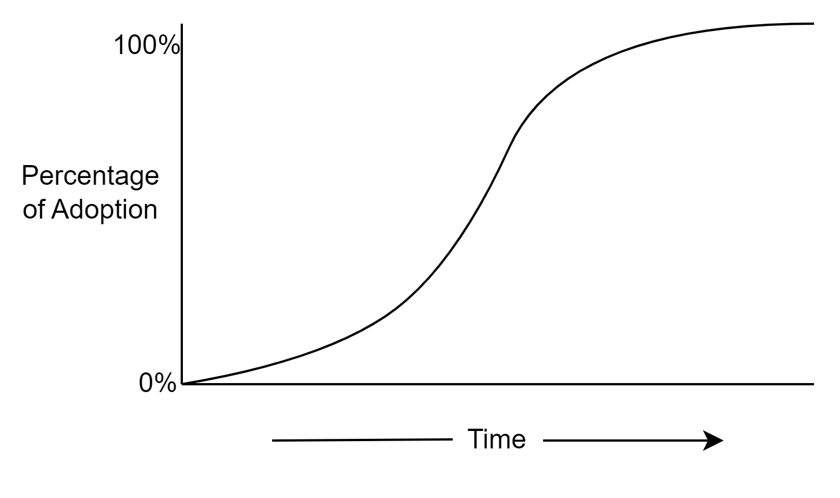
3. Time
“… is involved in diffusion in (1) the innovation-decision process by which an individual passes from first knowledge of an innovation through its adoption or rejection, (2) the innovativeness of an individual or other unit of adoption (that is, the relative earliness/lateness with which an innovation is adopted) compared with other members of a system, and (3) an innovation’s rate of adoption in a system, usually measured as the number of members of the system who adopt the innovation in a given time period.”
– Everett M. Rogers (page 20)
Source: A modified version of Figure 1-2. The Diffusion Process (Rogers, 2003, p. 11)
Notes:
The third element in the process of diffusion is Time.
Time [Read #1]
Going in reverse order of this description;
Adoption occurs over time.
Will typically follow an S-shaped curve and not be linear or immediately exponential. (see the curve on the slide)
When implementing changes that require the adoption of new practices, processes, and tools there will be various factors that hinder or delay adoption such as:
stakeholder (client) availability;
other business priorities; and
Our team resources and capacity to support the change.

Slide 34
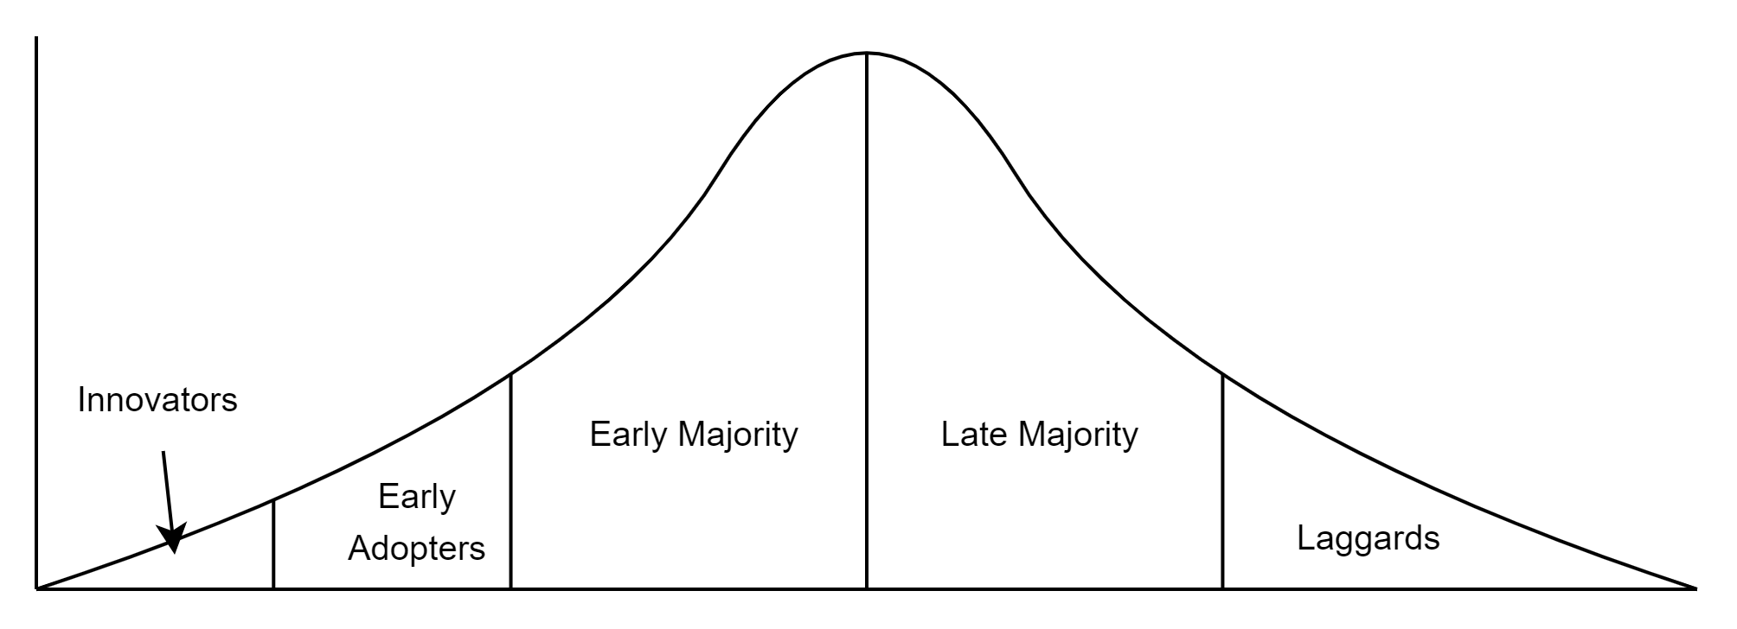
3. Time – Adopter Categorization
Source: A modified version of Figure 7-3. Adopter Categorization on the Basis of Innovativeness (Rogers, 2003, p. 281)
Notes:
(Slide 1 of 4)
“The innovativeness of an individual or other unit of adoption compared with other members of a system”;
This refers to where an individual, or group, finds themselves on this distribution of adopter categories;
If these categories look familiar, it’s likely that you’ve heard them used in the context of marketing.
The type of adopter plays a role in the rate of adoption, and it is likely that you’ve met and interacted with people in each.
Rogers identifies five ideal adopter categories to classify an individual’s or group’s innovativeness;
which is “the degree to which an individual or other unit of adoption is relatively earlier in adopting new ideas than other members of a system.”;
These are Innovators, Early Adopters, Early Majority, Late Majority, and Laggards;

Slide 35
3. Time – Adopter Categorization
Source: A modified version of Figure 7-3. Adopter Categorization on the Basis of Innovativeness (Rogers, 2003, p. 281)
Notes:
(Slide 2 of 4)
Each adopter category has different needs, is motivated by different drivers, and will require different levels of effort to guide them through the innovation-decision process.
The figure is a general depiction of the distribution of adopters by adopter category.
Rogers describes attributes for each category.
Notable attributes are:
Innovators are venturesome, interested in new ideas, tolerate high risk, can understand complex technical knowledge, and can cope with a high degree of uncertainty, and are willing to accept an occasional setback when a new idea proves unsuccessful;

Slide 36
3. Time – Adopter Categorization
Source: A modified version of Figure 7-3. Adopter Categorization on the Basis of Innovativeness (Rogers, 2003, p. 281)
Notes:
(Slide 3 of 4)
Early Adopters embody success, are champions and role models that are respected by their peers, and help decrease uncertainty about a new idea and adopting it;
Early Majority adopters interact frequently with peers, may deliberate for some time before adopting a new idea, have a longer innovation-decision process, and are willing to adopt innovations but not lead;
Late Majority adopters are skeptical, are influenced to adopt innovations by external forces such as out of necessity or peer pressure, require that norms favour the innovation first, and that uncertainty about a new idea is removed before they are convinced to adopt it;

Slide 37
3. Time – Adopter Categorization
Source: A modified version of Figure 7-3. Adopter Categorization on the Basis of Innovativeness (Rogers, 2003, p. 281)
Notes:
(Slide 4 of 4)
Laggards may be more isolated from other adopters; they are traditionalist, resistant to change, they rely on the past as a point of reference for decision making and are cautious and suspicious of innovations; and they have a lengthy innovation-decision process and require certainty about the success of an innovation.
With this general understanding of adopter categories and their attributes, we can better plan changes to support each;
Additionally, we can build profiles of good individuals and teams to work with in the early stages of capability development;
including the pilots and initial launch where it is best to find and work with the innovators and early adopters to obtain early successes.
(Rogers, 2003, pp. 282-285)

Slide 38
3. Time – Innovation-Decision Process
Five steps in the innovation-decision process:
Knowledge
Persuasion
Decision
Implementation
Confirmation
Notes:
Lastly, but also firstly;
In the element of Time there is a the innovation-decision process;
This is the process individuals go through from first learning about an innovation;
To forming an opinion about the innovation;
To making a decision to adopt or reject the innovation;
To implementing or specifically adopting and using the innovation;
To confirming their decision.
So, the five steps in the innovation-decision process are
[Read 1-5]
Do these steps look similar to an OCM methodology? (ADKAR)

Slide 39
3. Time – Types of Knowledge About a Change
Awareness-knowledge stems from the information that an innovation exists
How-to-knowledge stems from the information necessary to use an innovation properly
Principles-knowledge stems from the information about the functioning principles underlying how an innovation works
Notes:
(Slide 1 of 2)
Within the innovation-decision process;
Knowledge is the first step;
Not everyone requires the same level of knowledge or the same type of knowledge to make a decision to adopt a new capability.
In Diffusion of Innovation, Rogers describes the three types of knowledge:
Awareness-knowledge stems from the information that an innovation exists
Example: Policy statements, communications that socialize the capability, etc.
How-to-knowledge stems from the information necessary to use an innovation properly
Example: procedures, how-tos, instructional training, methodologies, etc.

Slide 40
3. Time – Types of Knowledge About a Change
Awareness-knowledge stems from the information that an innovation exists
How-to-knowledge stems from the information necessary to use an innovation properly
Principles-knowledge stems from the information about the functioning principles underlying how an innovation works
Notes:
(Slide 2 of 2)
Principles-knowledge stems from the information about the functioning principles underlying how an innovation works
Example: in-depth understanding of the specific methods a vulnerability scanner uses to identify a vulnerability and why it works.
So do these matter?
Depending on how you intend a capability to be adopted stakeholders will need some knowledge to enable adoption;
In most cases, there will be a need to create and socialize awareness-knowledge and where action or participation is required likely some how-to-knowledge.
(Rogers, 2003, p. 173)

Slide 41
4. A Social System
“A social system is defined as a set of interrelated units that are engaged in joint problem solving to accomplish a common goal. The members or units of a social system may be individuals, informal groups, organizations, and/or subsystems.”
– Everett M. Rogers (page 23)
Notes:
The final, and fourth, element in the process of diffusion is A Social System;
Rogers says that [Read #1]
The sharing of ideas and knowledge occurs between individuals and therefore in a social system;
The structure of the social system can either facilitate and enable or impede diffusion.
Our social systems comprise of the organizational structure, teams, relationships, culture, and team topologies;
These all play a role and without this this system;
awareness and knowledge cannot be spread.

Slide 42
Controlling Rate of Adoption and Factors in Change Success
Success in securing adoption is positively related to…
The extent of change-agent effort in contacting clients.
Client orientation. Change agents that have a closer rapport with their clients enjoy higher credibility in the eyes of their clients and base their diffusion activities primarily on clients’ needs.
The degree to which a diffusion program is compatible with clients’ needs.
Change agent empathy for clients.
Notes:
(Slide 1 of 2)
Last bit on adoption;
Outside of the process of diffusion Rogers describes 4 factors in change success and variables that influence the rate of adoption;
These are things change-agents (that is we, those developing and implementing capabilities) should consider;
To create a favourable adoption environment;
[Read #1 and sub-points]
Change agent effort: Are we socializing the ideas, raising awareness, providing training, checking in, providing support?
Client orientation: There is difference between being an outside group, separate from development which is often the case for AppSec and Security, vs being part of the development group;

Slide 43
Controlling Rate of Adoption and Factors in Change Success
Success in securing adoption is positively related to…
The extent of change-agent effort in contacting clients.
Client orientation. Change agents that have a closer rapport with their clients enjoy higher credibility in the eyes of their clients and base their diffusion activities primarily on clients’ needs.
The degree to which a diffusion program is compatible with clients’ needs.
Change agent empathy for clients.
Notes:
(Slide 2 of 2)
Compatibility with clients’ needs: This goes back to the second attribute influencing rate of adoption. Does this change align with our needs, values, norms, etc.?
Lastly;
Change agent empathy: Do we understand our adopters’ perspective? Priorities? Challenges? Are we solving problems or making them worse?
How we approach each of these can and will have a direct impact on successful adoption.
(Rogers, 2003, pp. 373-376)

Slide 44
Adoption Summary and Takeaways
We can help others help us by doing the work necessary to achieve the desired level of adoption.
Using the Process of Diffusion
We can increase adoption success by considering the the five attributes influencing rate of adoption and creating a favourable environment to enable adoption.
A capability cannot be adopted without awareness and knowledge about the capability which requires communication.
Adoption takes time and adopters go through an innovation-decision process. Supporting this process is critical.
Knowledge is a key part of this process and different groups and adopters require different levels of knowledge.
Adopter categories help explain why some easily adopt new practices while others resist.
Our pilots are best suited for Innovators and Early Adopters to help us with testing changes and provide early and observable results.
Notes:
This was a heavy section so here is a summary of our takeaways.
[Read slide]

Slide 45
Team Topology

Slide 46
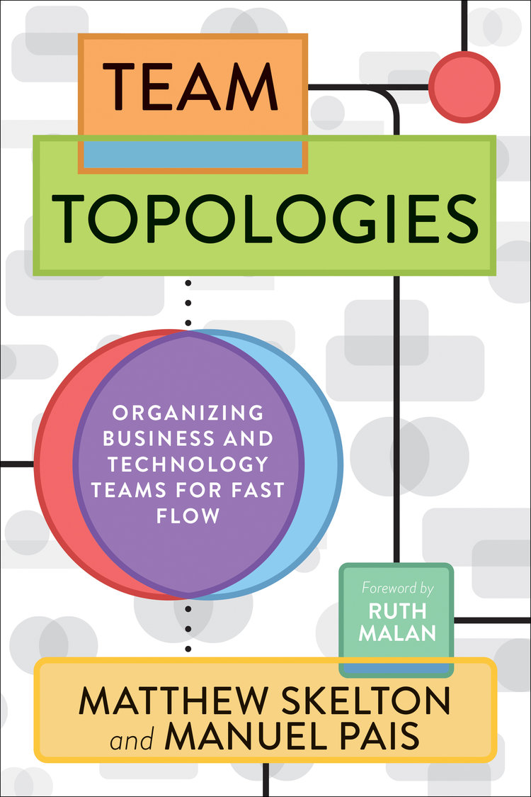
Team Topology
“Team Topologies: Organizing Business and Technology Teams for Fast Flow”
Matthew Skelton and Manuel Pais
(2019)
Notes:
The concepts and language I’ll be introducing on team topology are derived from the book “Team Topologies” by Skelton and Pais.
Only scratch the surface on this topic in this talk, but I highly recommend anyone designing teams, services, and capabilities consider having a deeper look.

Slide 47
Why Think About Team Topology?
“Team Topologies clarifies team purpose and responsibilities, increasing the effectiveness of their interrelationships.” – Skelton and Pais (page 2)
Changes how view ourselves as components in a larger system.
Changes how we approach achieving our collective goals and objectives.
Helps us better understand our teams’ priorities and focus helping better manage our cognitive load (team capacity) and become more aware of the cognitive load of others.
Notes:
(Slide 1 of 2)
Improving the security of software and applications requires;
participation, cooperation, and collaboration between various teams;
The way that teams work with each other and interact are influenced by how teams are structured and their topologies (i.e., their purpose and relationships with one another);
According to Skelton and Pais;
[Read #1]
This can impact how we view ourselves as components in a larger system;
And change how we approach organizing our team(s) for achieving our goals and objectives.

Slide 48
Why Think About Team Topology?
“Team Topologies clarifies team purpose and responsibilities, increasing the effectiveness of their interrelationships.” – Skelton and Pais (page 2)
Changes how view ourselves as components in a larger system.
Changes how we approach achieving our collective goals and objectives.
Helps us better understand our teams’ priorities and focus helping better manage our cognitive load (team capacity) and become more aware of the cognitive load of others.
Notes:
(Slide 2 of 2)
This also helps us better understand our teams’ priorities;
And focus helping better manage our cognitive load (or team capacity);
while also becoming more aware of the cognitive load of others.

Slide 49
Topologies According to Skelton and Pais
Stream-Aligned
Enabling
Platform
Complicated-Subsystem
Notes:
(Slide 1 of 5)
There are four fundamental team topologies as described in the Team Topologies book by Matthew Skelton and Manuel Pais.
These topologies are [Read slide]
Each topology has specific characteristics:
Stream-Aligned Team: Skelton and Pais say that “A ‘stream’ is the continuous flow of work aligned to a business domain or organizational capability”
“A stream-aligned team is a team aligned to a single, valuable stream of work”
Example: Application security or QA.

Slide 50
Topologies According to Skelton and Pais
Stream-Aligned
Enabling
Platform
Complicated-Subsystem
Notes:
(Slide 2 of 5)
Stream-Aligned Team: Skelton and Pais say that “A ‘stream’ is the continuous flow of work aligned to a business domain or organizational capability”
“A stream-aligned team is a team aligned to a single, valuable stream of work”
Example: Application security or QA.

Slide 51
Topologies According to Skelton and Pais
Stream-Aligned
Enabling
Platform
Complicated-Subsystem
Notes:
(Slide 3 of 5)
Enabling Team: “An enabling team,” according to Skelton and Pais, “is composed of specialists in a given technical (or product) domain, and they help bridge this capability gap.” Enabling teams “have the required bandwidth to research, try out options, and make informed suggestions on adequate tooling, practices, frameworks, and any of the ecosystem choices around the application stack.”
The “end goal of an enabling team is to increase the autonomy of stream-aligned teams by growing their capabilities with a focus on their problems.
If done well, teams that are helped by an enabling team should only need help for a short period and there shouldn’t be a be a permanent dependency the enabling team;
Examples: DevOps teams that build skeleton pipelines to enable development teams;

Slide 52
Topologies According to Skelton and Pais
Stream-Aligned
Enabling
Platform
Complicated-Subsystem
Notes:
(Slide 4 of 5)
Complicated-Subsystem Team: “A complicated-subsystem team is responsible for building and maintaining a part of the system that depends heavily on specialist knowledge”, according to Skelton and Pais;
Example: (the may not be the best example but…) a DevSecOps group within a DevOps team that is responsible for security tooling, automation, and integration with build and deployment pipelines.

Slide 53
Topologies According to Skelton and Pais
Stream-Aligned
Enabling
Platform
Complicated-Subsystem
Notes:
(Slide 5 of 5)
And finally we have a Platform Team;
The “purpose of a platform team is to enable stream-aligned teams to deliver work with substantial autonomy … The platform team provides internal services to reduce the cognitive load that would be required from stream-aligned teams to develop these underlying services.”
In Team Topologies, Skelton and Pais refer to Evan Bottcher’s definition of a “platform” to describe what it entails:
Bottcher says, “A digital platform is a foundation of self-service APIs, tools, services, knowledge and support which are arranged as a compelling internal product.”
Perhaps at this point you may start to see how you presently fit into one or more of these topologies in your day job.
Logically, and in practice, each team may be a composition of multiple team topologies.
(Skelton & Pais, 2019, p. 81)
(Skelton & Pais, 2019, pp. 86-87)
(Skelton & Pais, 2019, p. 91)
(Skelton & Pais, 2019, p. 92)
(Bottcher, 2018)

Slide 54
Interaction Modes
Collaboration
X-as-a-Service
Facilitating
Notes:
The 3 interaction modes identified and describe by Skelton and Pais are a bit more straight forward.
There is:
Collaboration: “Working closely together with another team”
X-as-a-Services: “Consuming or providing something with minimal collaboration”
Facilitating: “Helping (or being helped by) another team to clear impediments”
(Skelton & Pais, 2019, p. 133)

Slide 55
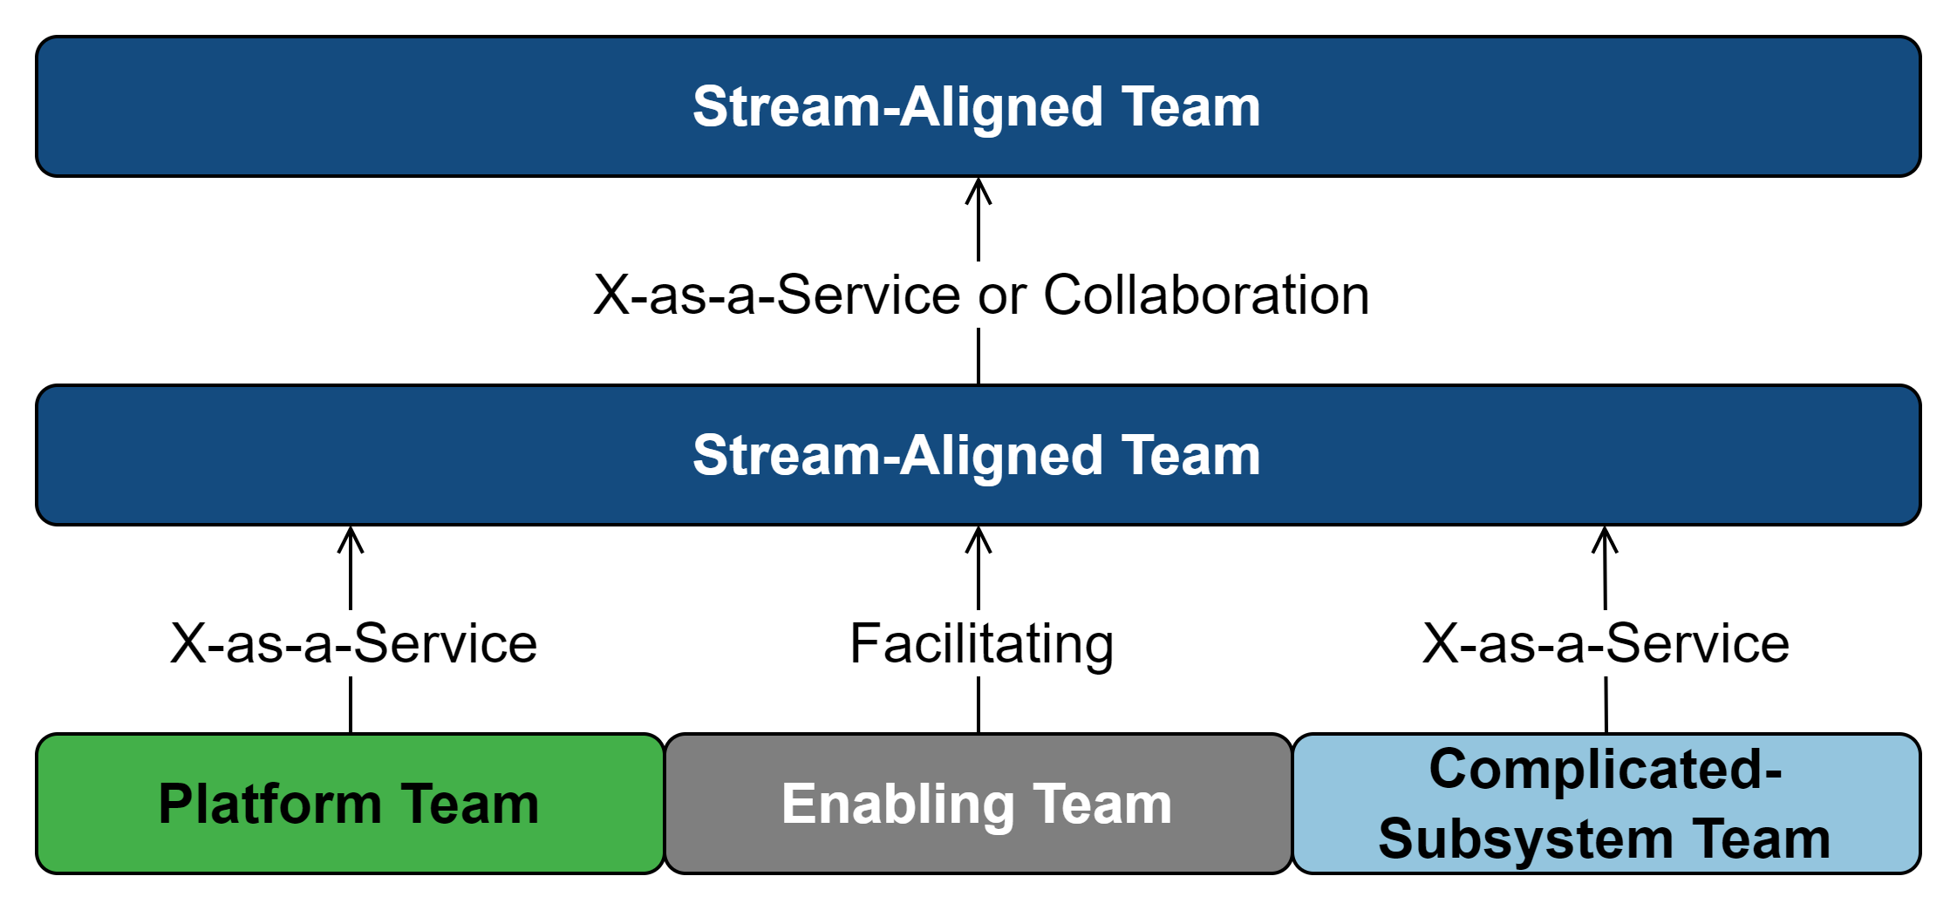
Topologies and Common Interaction Modes
Source: A summarized depiction of Table 7.4: Team interaction modes of the fundamental team topologies (Skelton & Pais, 2019, p. 144)
Notes:
Why does this all matter?
Consider this diagram that is depicting these team topologies and their common interaction modes;
If our team, say AppSec, is Stream-Aligned;
and delivering a vulnerability management services that;
includes scanning, triage, prioritization and reporting to other teams;
but we desire this capability to be more “self-service”;
We should then consider either shifting some priorities;
Or standing up a team dedicated to building the platform;
Thus, adopting characteristics of a Platform Team.
Otherwise, if we continue with the status quo, we cannot achieve our desired state.

Slide 56
Services
Notes:
Services!

Slide 57
Capabilities and Services
Capabilities are often realized and delivered through services.
Services involve interaction(s) between two parties.
One acts as a service provider, whether internal or external, and the other the customer consuming the service.
Notes:
Why talk about services?
As we saw in Team Topologies, teams often interact with each other through providing services.
In AppSec, we are often providing services internally;
Consider all the various styles of security assessments we do that involve specialist;
That review some aspect of a system and providing findings, a report, or their opinion.
AppSec capabilities are often realized and delivered through services;
Where two parties are involved;
One that is the service provider;
And the other is a customer consuming the service.

Slide 58
Definition of Service
“The application of specialized competences (knowledge and skills) through deeds, processes, and performances for the benefit of another entity or the entity itself”
– Adam Tacy (2021)
“A service is a process consisting of a series of more or less intangible activities that normally, but not necessarily always, take place in interactions between the customer and service employee and/or physical resources or goods and/or systems of the service provider, which are provided as solutions to customer problems.”
– Christian Grönroos (2000)
Notes:
By now, you may have realized I like to have definitions to make sure we are all on the same page;
So here are two definitions that resonate with me for our purposes in understanding services.
Adam Tacy defines a service as [Read #1]
And Christian Grönroos, a professor of service and relationship marketing has defined a service as;
[Read #2]
Parts of the definitions that stand out to me include:
That services are the use of knowledge and skills;
Through processes or activities;
To provide a solution to one or more problems.
https://solvinnov.com/a-model-for-describing-a-service-and-better-still-systematically-discovering-services-innovations/
https://solvinnov.com/what-are-services/

Slide 59
Quick Tangent…
There is a great website (https://solvinnov.com/) by Dr. Adam Tacy that contains articles/blogs, summaries, and references to related material and many of the material I’ve used in this section and throughout presentation.
Dr. Tacy has referenced and cited their material which is very useful and refreshing in a world of unsourced blog material.
Notes:
[Read slide]

Slide 60
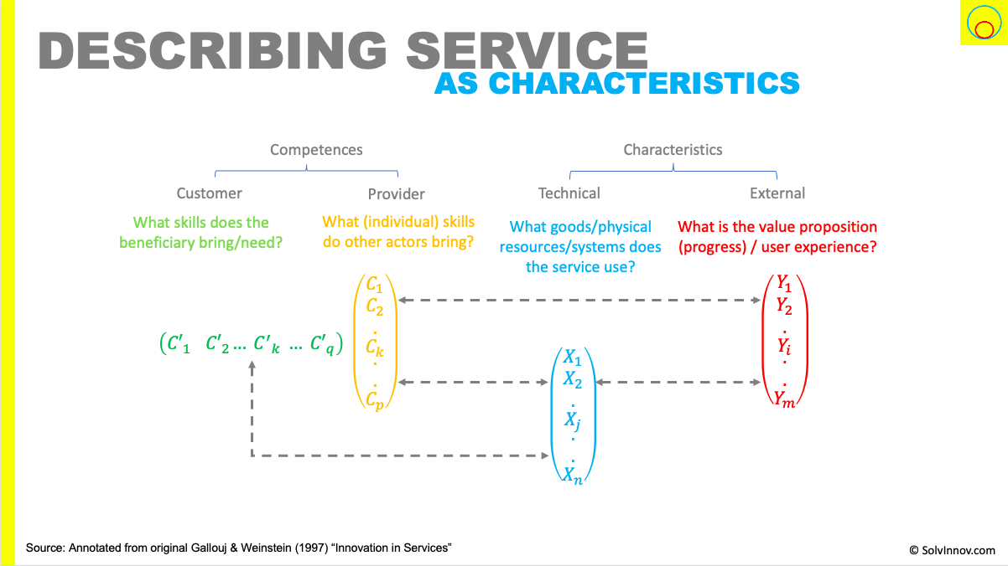
Describing Service as Characteristics
Source: https://solvinnov.com/a-model-for-describing-a-service-and-better-still-systematically-discovering-services-innovations/
Original Source: https://shs.hal.science/halshs-01133098/document
Notes:
Ok back to talking about services;
In their paper “Innovation in Services”, Gallouj and Weinstein define a service by four characteristics:
Dr. Adam Tacy has summarised this definition in the figure displayed on screen. Let’s look a bit closer.
Customer competences, what skills or knowledge do the customers require?;
Provider competences, what skills or knowledge does the provider bring?;
Technical characteristics, what resources or systems does the service use or are dependent on?; and
External characteristics, what is the value proposition or user experience?;
This method of defining services I think provides a great way to conceptualize services.

Slide 61
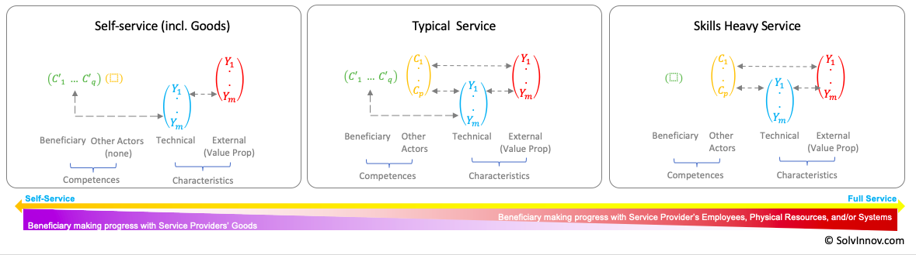
Service Types
Source: https://solvinnov.com/service-as-characteristics-examples/
Notes:
Now that we’ve talked extensively about what services are;
And… stay with me a little longer;
Let’s look at a quick comparison between 3 different types of services that I think are applicable to many of us;
Self-Service: Defined by “…the reliance on [consumer] skills and their use of … [resources] provided by the [service provider]...”;
Typical Service: Characterised by a service “… that have obvious co-value generation through the integration of [consumer] and [provider] competences to realise the [value proposition]…”; and lastly we have
Skills Heavy Service: A service that “… relies heavily on [provider] competences and have a negligible need for [consumer] competences during the act of service.”
https://solvinnov.com/service-as-characteristics-examples/
https://solvinnov.com/a-model-for-describing-a-service-and-better-still-systematically-discovering-services-innovations/

Slide 62
Self-Guided Services
Notes:
This brings us Self-Guided services
With increasing pressure to do more with the same, or fewer, resources;
More and more teams are looking to solve this problem by distributing the cognitive load of AppSec processes;
through “self-service” delivery models;
As we’ve seen up to this point;
Adoption requires knowledge;
A platform provides the foundations to enable autonomy for other teams; and
Self-Service requires that service beneficiary, or consumer, have the required competencies to execute the service;
Which means a state where the service can be performed without the provider.

Slide 63
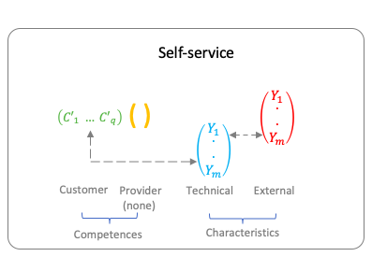
Self-Guided Services (Self-Service)
Self-service is a target state of autonomy where consumers of a capability can perform the capability without the support of specialists.
Self-service requires a platform to enable competence transfer from provider to consumer.
Enabling adoption of a self-service capability requires the following:
Awareness
Education and training
Post-training reinforcement
Supporting documentation
Tools
Automation
Support services
Clear guidance and expectations
Source: https://solvinnov.com/a-model-for-describing-a-service-and-better-still-systematically-discovering-services-innovations/
©solvinnov.com
Notes:
Which brings us here;
[Read slide]
Without these we cannot reasonably expect “self-service” to be a reality.
https://solvinnov.com/a-model-for-describing-a-service-and-better-still-systematically-discovering-services-innovations/

Slide 64
Capability Measurement
Defining Success
Notes:
Ok, final topic in this talk;
Measuring a capability; and
Defining success.

Slide 65
Common Results-Driven Approach
Capabilities are frequently measured on results only informed by superficial metrics.
Using data generally readily available in our tools.
Examples:
Number of vulnerabilities identified
Reduction in vulnerabilities in a defined time period
Number of security assessments performed
Problem: When implementation and operationalizing a capability, results don’t tell us the entire picture and therefore cannot adequately support decision making.
Notes:
The approach we commonly see, we can label as being a “results-driven” or “outcome-driven” approach to measuring success;
This works for well established and adopted capabilities and usually involves simple metrics based off readily available data from our tools;
Such as the number of vulnerabilities identified, or the number of vulnerability reduces in a time period;
The issue with this approach, especially for new or unadopted capabilities;
Is that it doesn’t tell the full story;
And as we scale the capability and make efforts to increase adoption there is likely going to be a negative impact on these metrics.
For example, if we increase adoption of vulnerability scanning, we can reasonably expect an increase in vulnerabilities identified each time a new system is onboarded and scanned;
This negatively impacts the objectives we may have around decreasing vulnerability each quarter.

Slide 66
If not results, then what?
“’Change agents’ success in securing the adoption of innovations by clients is positively related to the extent of change agent effort in contacting clients.”
– Everett M. Rogers (page 373)
Results
Adoption
Change Effort
Notes:
(Slide 1 of 5)
What should we then measure?;
Going back to Everette Rogers’ factors that influence adoption and rate of success;
Rogers says, [read quote].
In other words, we get out what we (change agents) put in;
We cannot expect success unless we create an environment that will enables success;
Therefore, we need to measure various aspects of a capability that include implementation progress (i.e. scaling and change efforts), adoption, and results.
I propose looking at it in this order;
Change effort
Adoption
Results

Slide 67
If not results, then what?
“’Change agents’ success in securing the adoption of innovations by clients is positively related to the extent of change agent effort in contacting clients.”
– Everett M. Rogers (page 373)
Results
Adoption
Change Effort
Notes:
(Slide 2 of 5)
Change efforts include any effort made by the capability owners to help the organization scale and adopt capabilities;
This may include;
Providing internal communications and marketing to raise awareness about the capability;
Training personnel on processes, procedures, and expectations;
Onboarding personnel and teams by provisioning access to tools and resources that support the capability; and
Providing services to support the capability.
Measuring change efforts will typically involve looking at whether a specific change-management activity was completed.

Slide 68
If not results, then what?
“’Change agents’ success in securing the adoption of innovations by clients is positively related to the extent of change agent effort in contacting clients.”
– Everett M. Rogers (page 373)
Results
Adoption
Change Effort
Notes:
(Slide 3 of 5)
Adoption is the measurement of indicators that a capability is adopted;
In other words, there is evidence that suggests the completion of associated processes and procedures and confirms usage;
For example, determining whether vulnerability scanning is adopted would require data that suggests or confirms that a development team is executing vulnerability scans frequently (i.e. more than once);
results are triaged;
and remediation is completed;

Slide 69
If not results, then what?
“’Change agents’ success in securing the adoption of innovations by clients is positively related to the extent of change agent effort in contacting clients.”
– Everett M. Rogers (page 373)
Results
Adoption
Change Effort
Notes:
(Slide 4 of 5)
Measuring adoption starts with defining what adoption means for a given capability and identifying the indicators of adoption;
Indicators may be soft indicators (i.e., indicators that, when combined with other context, confirm that adoption has occurred);
or hard indicators (i.e., indicators that alone confirm that adoption has occurred);
Measurement of adoption should focus on the rate of adoption and the percentage of adoption.

Slide 70
If not results, then what?
“’Change agents’ success in securing the adoption of innovations by clients is positively related to the extent of change agent effort in contacting clients.”
– Everett M. Rogers (page 373)
Results
Adoption
Change Effort
Notes:
(Slide 5 of 5)
And finally;
Measuring results is the final measurement that assesses a capability’s progress and impact;
Results should be tied to the capability’s purpose;
For example, the result-based objectives and metrics for vulnerability management should be related to the reduction or elimination of vulnerabilities;
To measure results, obtain a baseline as a starting reference point;
Then, focus the measurement of results on the changes from the baseline over time.

Slide 71
Notes:
That’s it!
Thank you for coming to my talk and sticking around until the end!

Slide 72
Jon Shapransky
Email: jon.shapransky@kroll.com
Twitter: @Jon.Shapransky
Mastodon: @Jon.Shapransky@infosec.exchange

Slide 73
Abstract
There are increasing requirements for organizations to improve their application security practices. To meet these requirements, organizations need to adopt capabilities whether practices (e.g., threat modelling, vulnerability scanning, etc.) or tools (e.g., SAST, SCA, DAST, CSPM, etc.). The value of hiring specialists and buying tools will not be realized unless the associated services, processes, procedures are adopted.
This talk will focus on presenting an approach to building capabilities and highlight underlying principles behind adoption. This framework covers both the general components of a capability and the components required to adopt a capability. We’ll present a framework that incorporates relevant third-party research from fields outside of security and applies them to the security domain to help explain why some are successful in implementing and adopting capabilities while others are not.
This talk is for anyone involved in designing, building, and managing application security and product security programs.
Takeaways:
Universal framework on capability development that prompts us to think about what we will need to ensure success and adoption.
Understanding of the principles behind adoption.
Perspective of how team topologies (structure and interactions) influences our ability to achieve desired results.
An approach to measuring progress.

Slide 74
Tags
Application Security
Product Security
Management
Technical Team Leads
Change Management
Adoption

